Slide 1



APPIAN
`25
AI APPLICATION CHALLENGE…..
Classification and processing of unstructured financial documents
Github Repo: joshjothom05
Team Name: joshjothom05
Team Leader Name: Joshua Thomas
Institution Name: National Institute of Technology Karnataka,Surathkal

Slide 2
TECHNOLOGY USED
OpenCV: For preprocessing image files and enhancing OCR accuracy.
Tesseract OCR: For text extraction from scanned images and PDFs.
Transformers Library: For leveraging state-of-the-art NLP models for text classification and entity recognition.
Pandas and NumPy: For managing and processing structured datasets.
PyTorch/TensorFlow: For training and deploying deep learning models.
Scikit-learn: For evaluation and fine-tuning of traditional machine learning classifiers.

Slide 3
DATA COLLECTION DETAILS
Files in form of annotations in order to train the model to identify different documents and their hierarchy and path.
Images in the same folder for both training and testing data to increase accuracy at identifying pictures and its’ contents and converting them to text.

Slide 4

DATA PREPROCESSING DETAILS
The data preprocessing phase involves extracting text from documents using Tesseract OCR for Optical Character Recognition. PDFs and image files are converted into machine-readable text. Tools such as OpenCV are employed to preprocess images, enhancing clarity and ensuring better OCR accuracy. Steps include noise removal, binarization, and alignment corrections. Metadata, such as file names and timestamps, is also extracted for linking documents to individuals.

Slide 5
TRAINING THE MODEL
Machine learning models are trained to classify documents into categories. The pipeline employs Transformer-based models like BERT or RoBERTa for text classification tasks. Pre-trained models are fine-tuned on labeled datasets to detect specific document types and extract key features, such as names, addresses, and financial details. Image classification models, such as ResNet or MobileNet, are used to validate image-based documents like IDs.

Slide 6
EVALUATING DETAILS
The trained models are evaluated using metrics such as accuracy, precision, recall, and F1-score. A test dataset containing diverse document types is used to simulate real-world scenarios. Errors are analyzed to identify common misclassifications or missed entities. This step ensures that the models generalize well across unseen data and maintain high reliability.

Slide 7
CONCLUSION
This solution will streamline Appian Credit Union’s document processing workflow, enhancing productivity and customer satisfaction. The robust pipeline, integrating advanced tools and models, ensures accurate categorization and summarization, laying a foundation for scalability and innovation in document management systems.

Slide 8
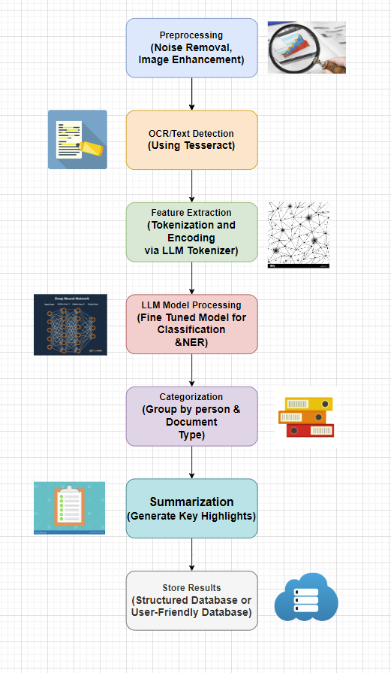
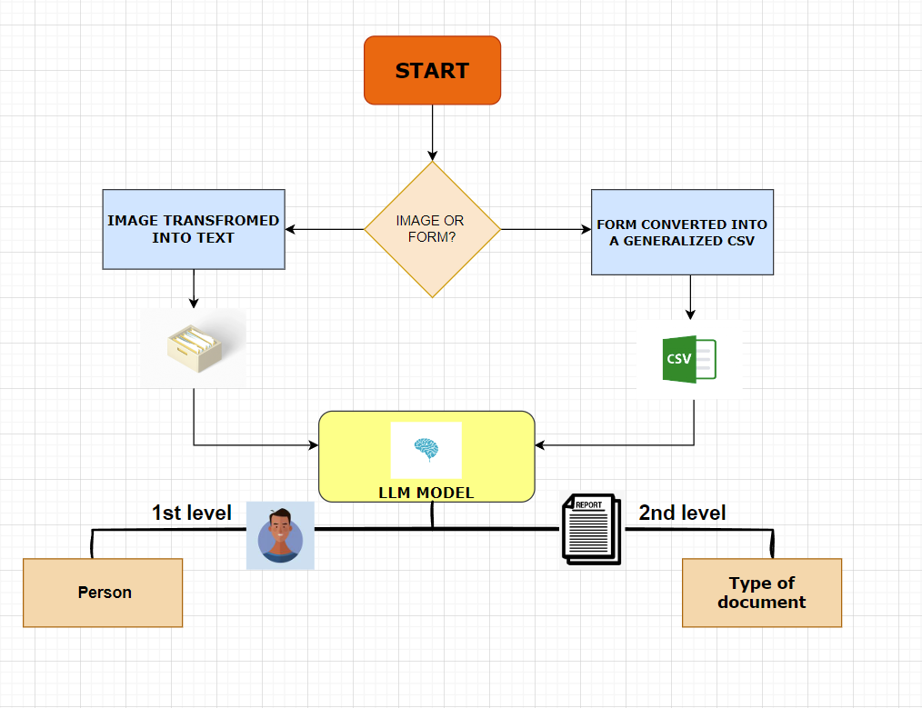
LLM MODEL
FLOWCHART

Slide 9
TEAM DETAILS
Team Leader Name: Joshua Thomas Johnson
Student ID: 231ME322
Institution Name: National Institute of Technology Karnataka, Surathkal
Phone Number: 8497010516
Email ID: joshjothom05@gmail.com

